Slide 1
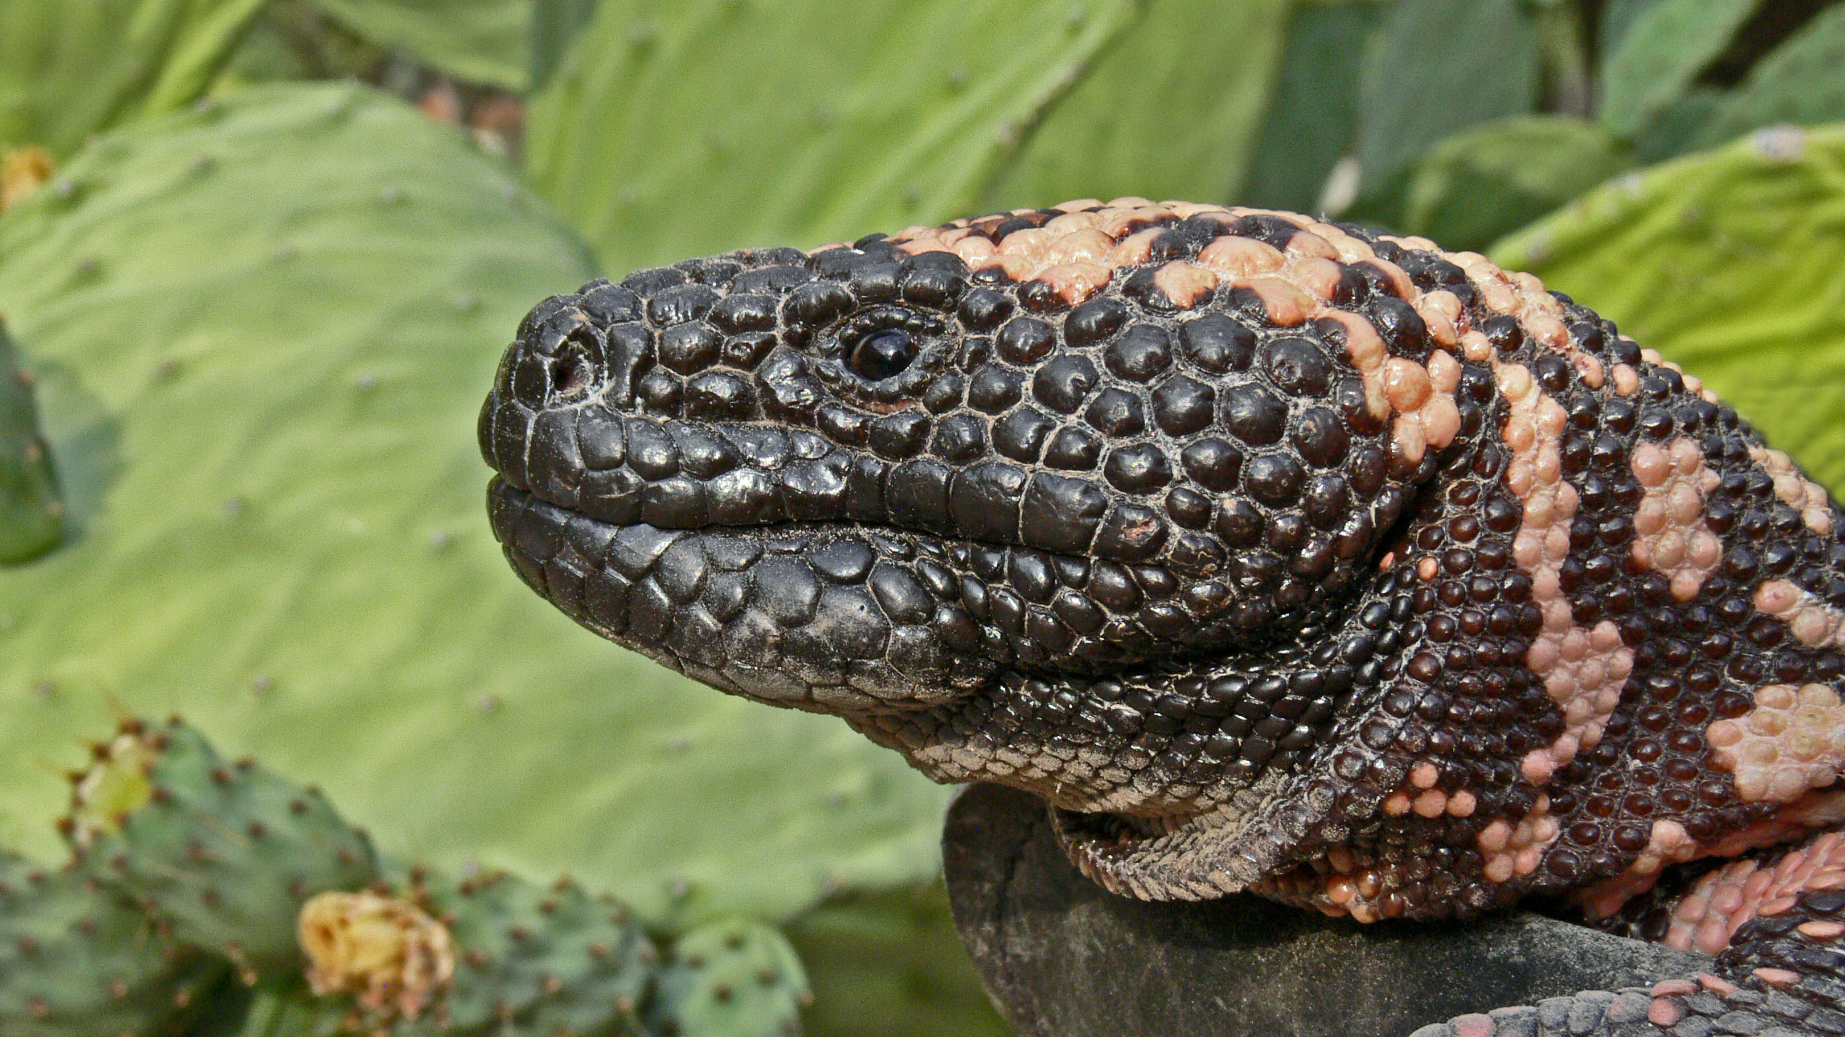



Effects of Urbanization on
Gila Monsters
Alexus Cazares and Matt Goode
Arizona Space Grant Symposium
April 13, 2019
Notes:
Hi, my name is Alexus Cazares and I am an undergraduate researcher at the University of Arizona.
I study Urban Ecology and today I will be talking about the effects of urbanization on a Gila Monster population.

Slide 2
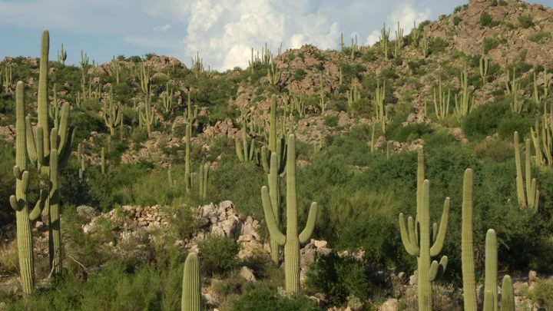
Notes:
Urbanization is one of the greatest threats to wildlife because it often leads to habitat alteration, or even habitat destruction, and it can also result in a loss of biodiversity.

Slide 3
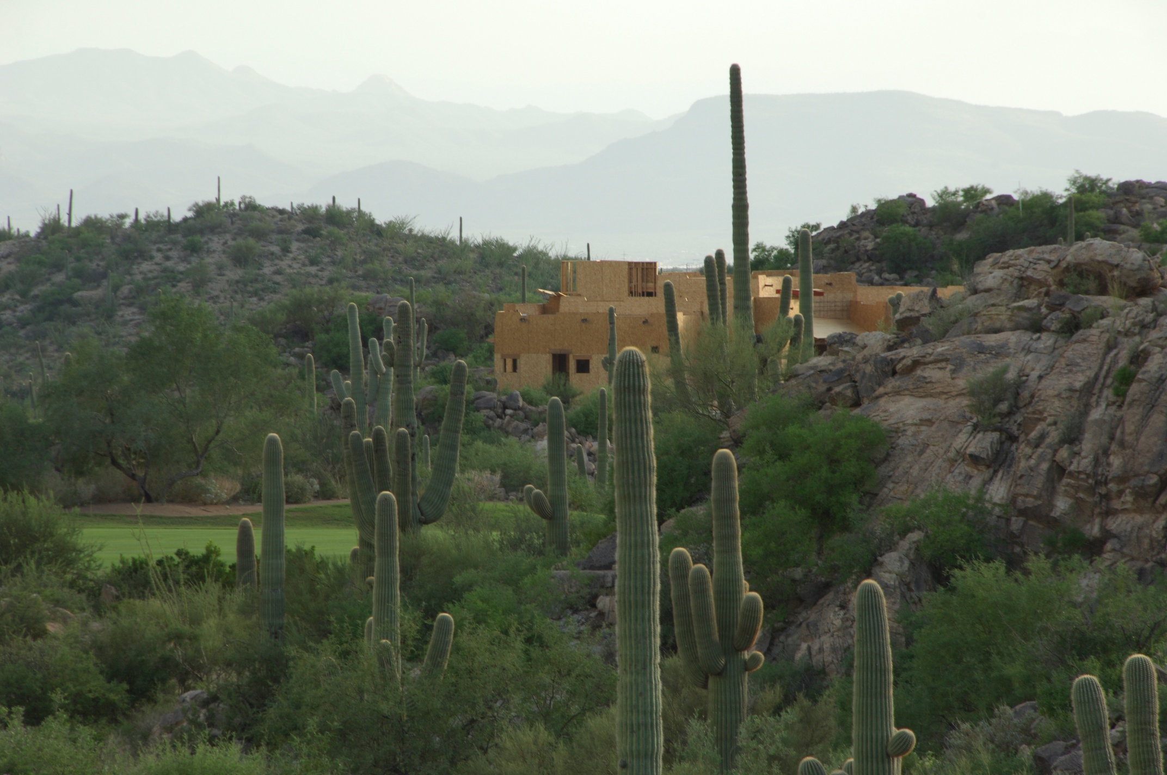
Notes:
As urbanization becomes a growing issue in the southwestern US, we see an increasing number of people moving into cities and expanding into the once uninhabited deserts.

Slide 4
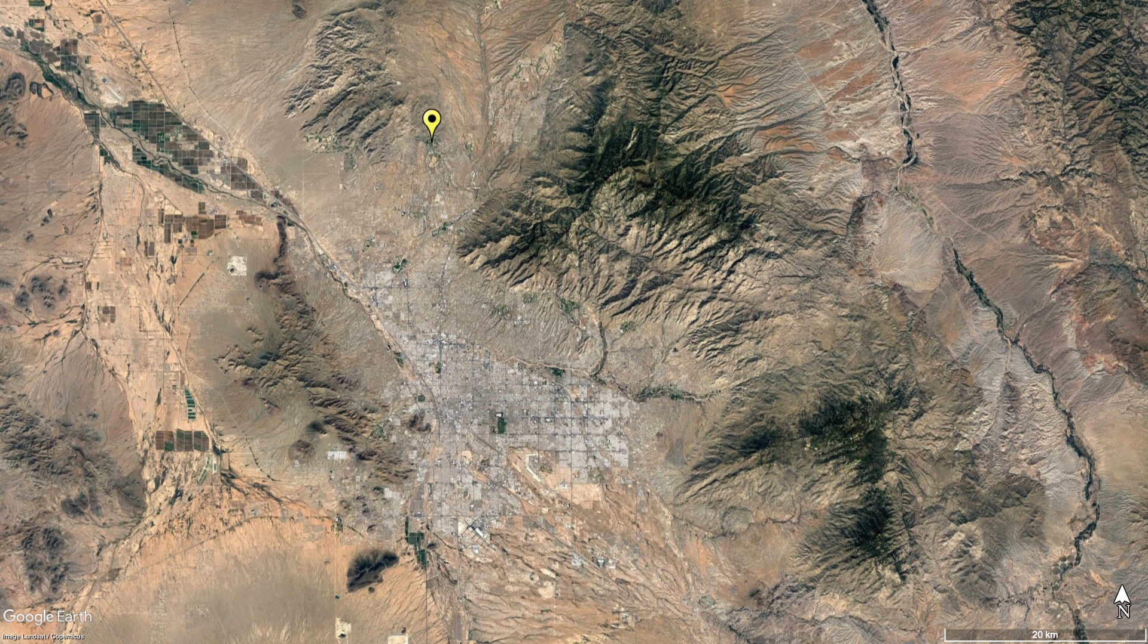
Tortolita Mountains
Stone Canyon
Santa Catalina Mountains
Tucson Mountains
Rincon Mountains
Notes:
My research focuses on the effects of urbanization at our study site, called stone canyon (which is shown here in yellow)
Stone canyon is a high end, residential golf community that is located at the base of the tortolita mountains in oro valley Arizona.

Slide 5
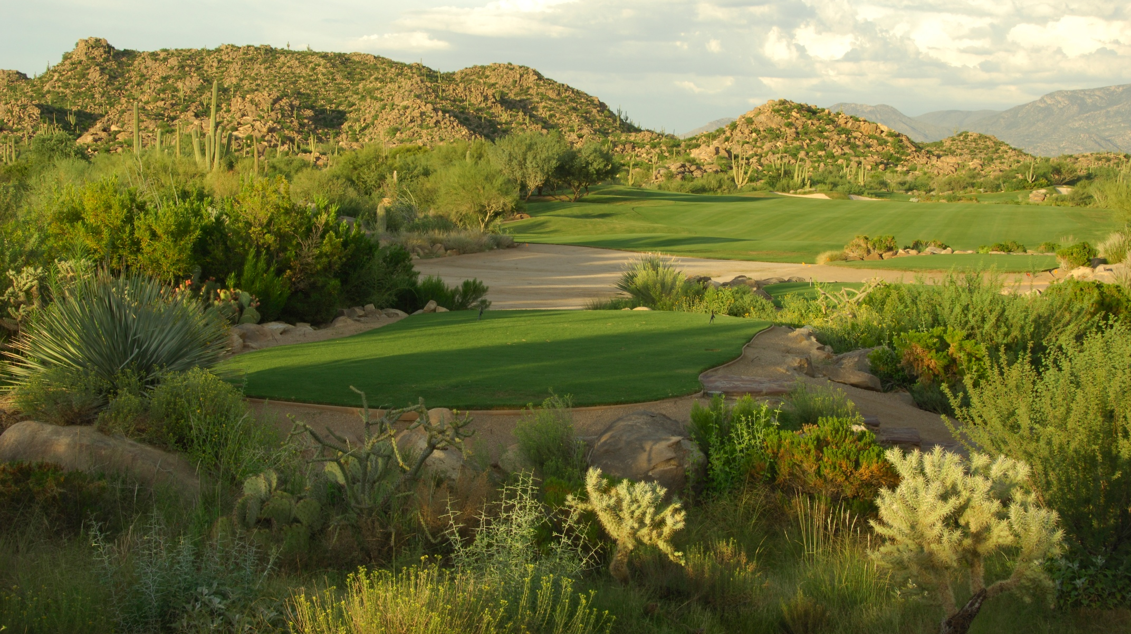
Notes:
Construction at this site began in 1999, and in 2000 the golf course was completed and ready for use.
In 2002, researchers began gathering data on the reptiles and amphibians found at this site.
You can also notice that Stone Canyon contains many rocky hillsides, which is the ideal habitat for Gila Monsters and other rock specialists.

Slide 6
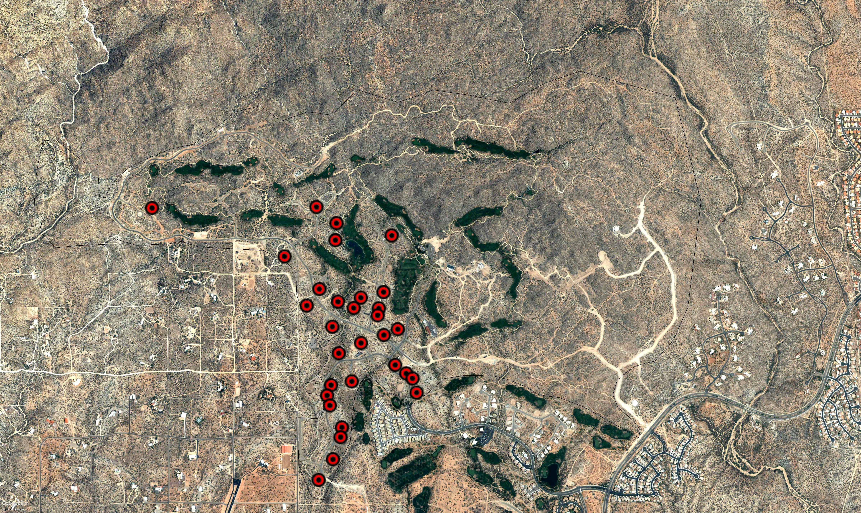
2003
31 Houses
Notes:
As you can see here, when we started this project in 2003-there were only about 39 houses.

Slide 7
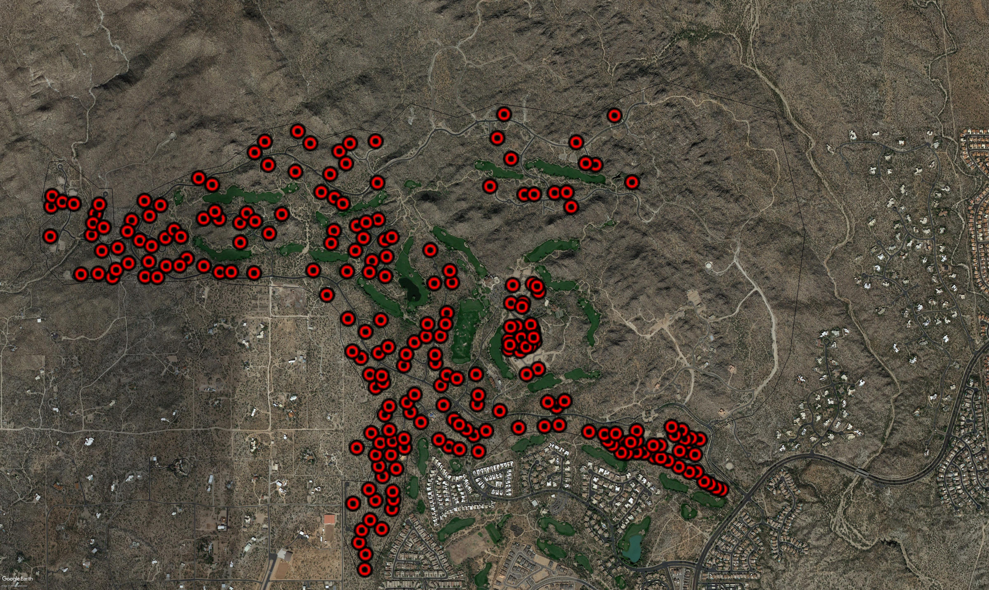
2018
230 Houses
Notes:
This is what Stone Canyon looks like today.
As you can see here, the number of houses at this site is rapidly increasing.

Slide 8
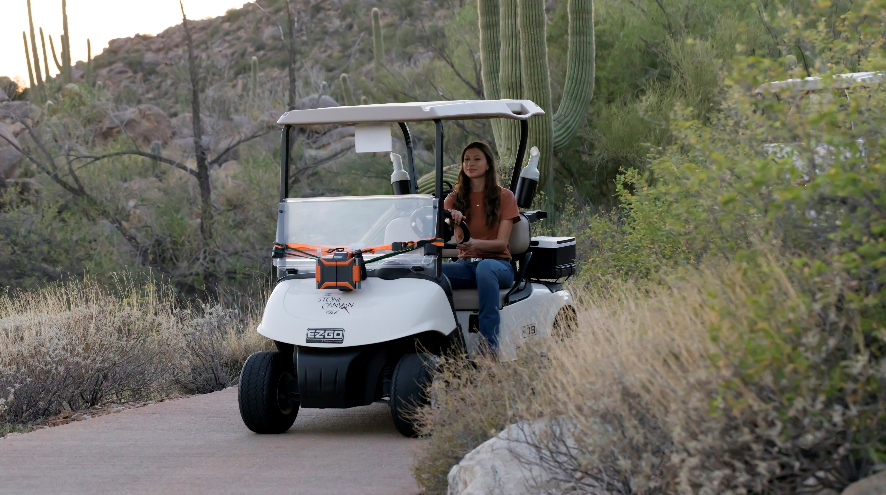
Notes:
On any given night, our field crew splits up into two groups—such that half of us cruise the roads while the other half cruises the cart path.

Slide 9
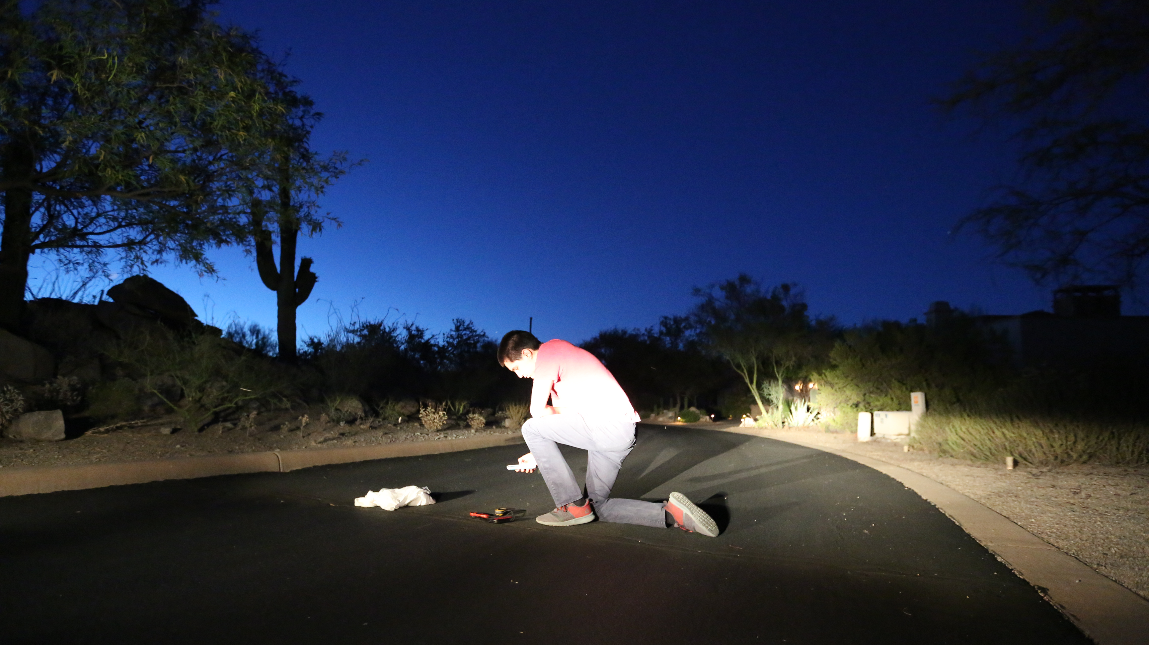

Slide 10
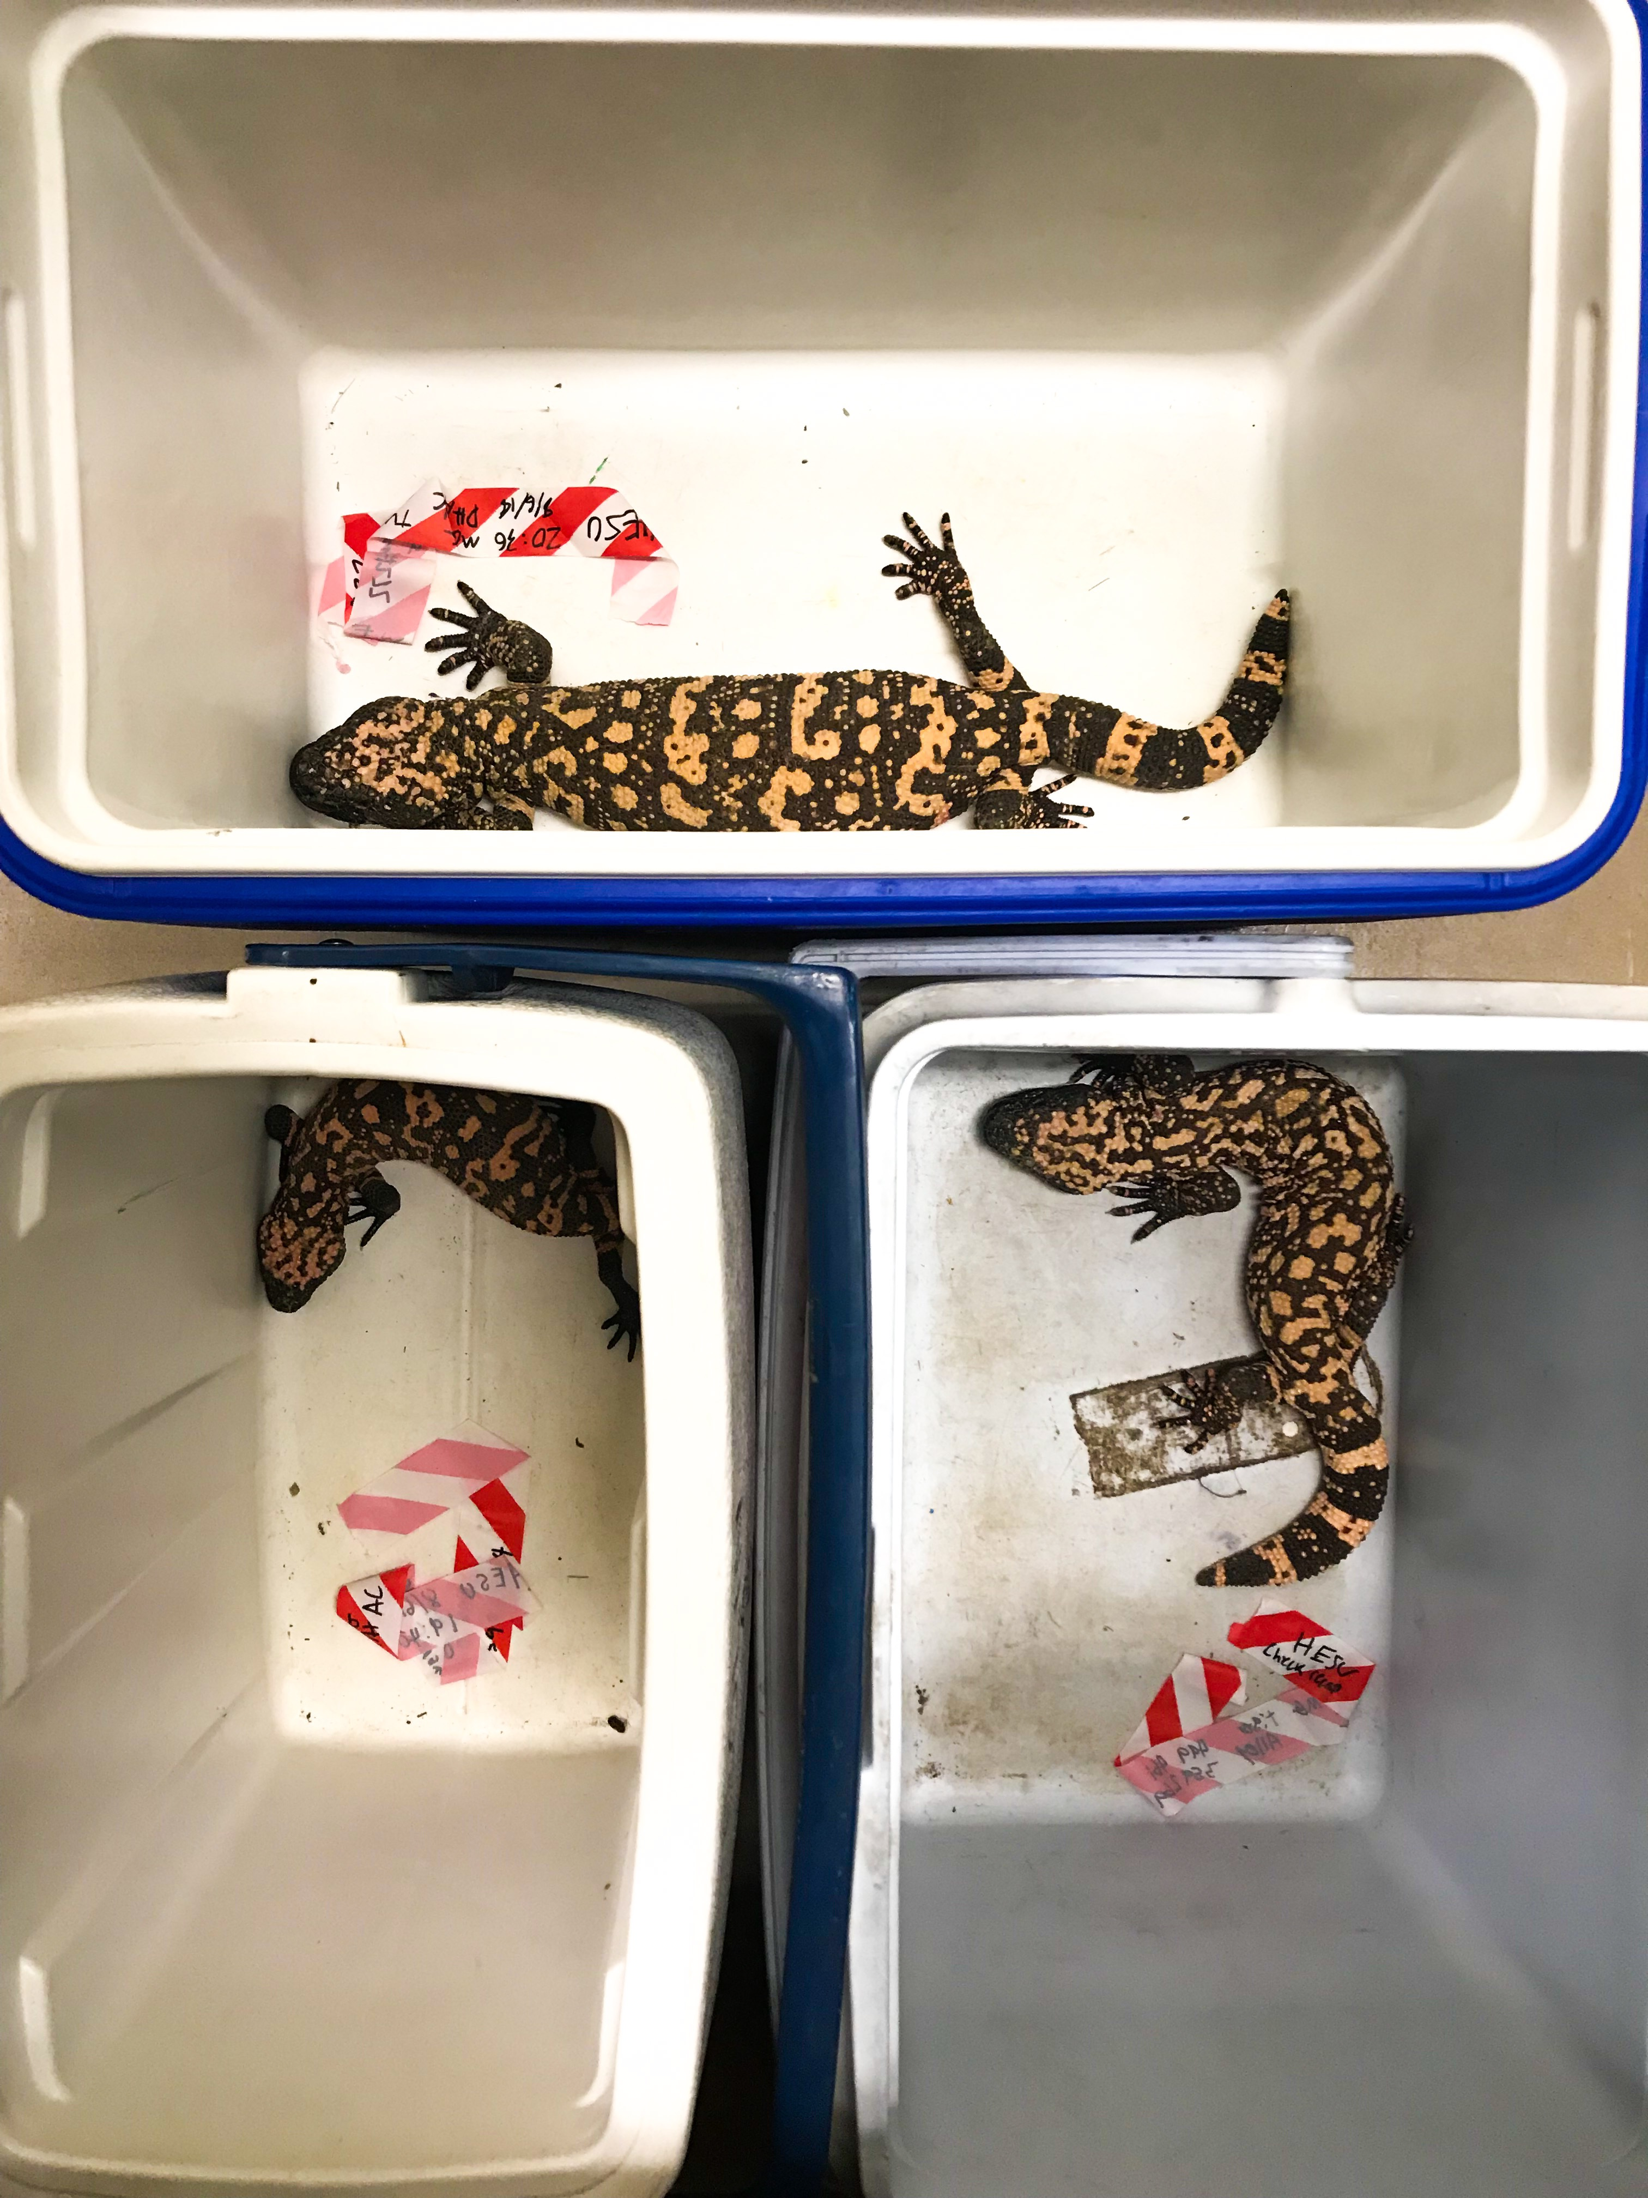
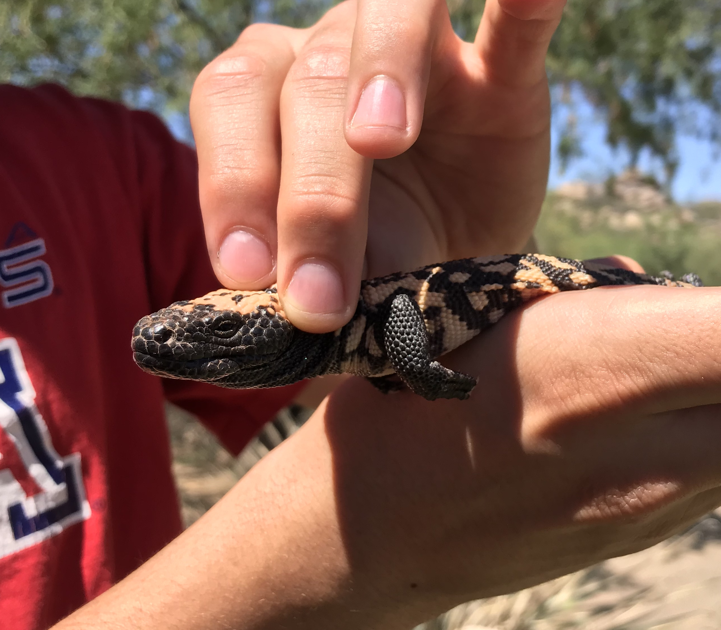

Slide 11
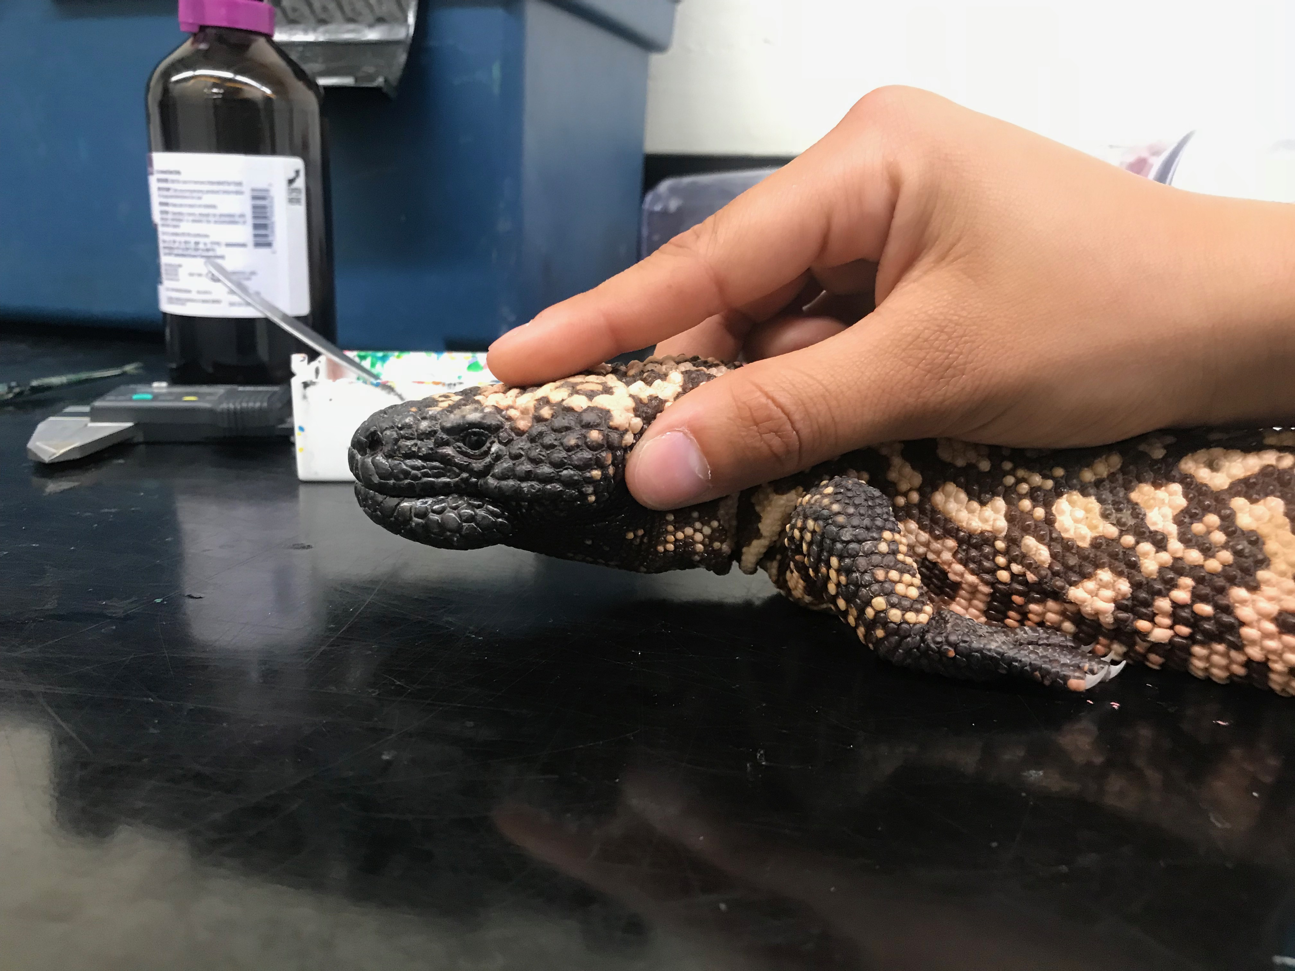

Slide 12
Results from 2003-2013 and 2017-2018
 | N
Total Observations | 642
Total Captures | 606
Unique Individuals | 320
Total Recaptures (2 to 17 times) | 304

Slide 14
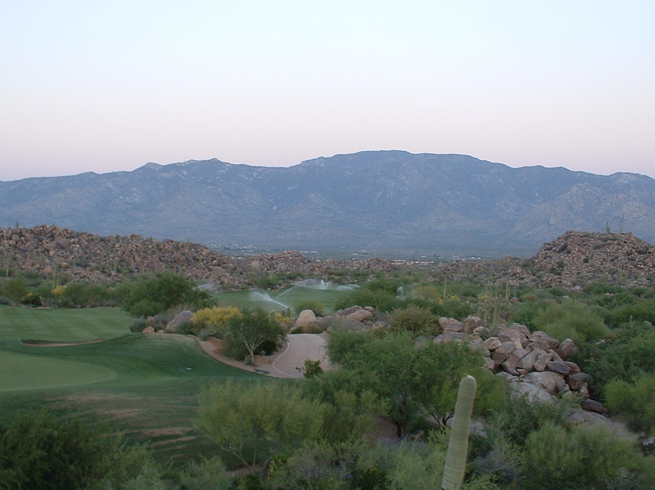

Slide 15
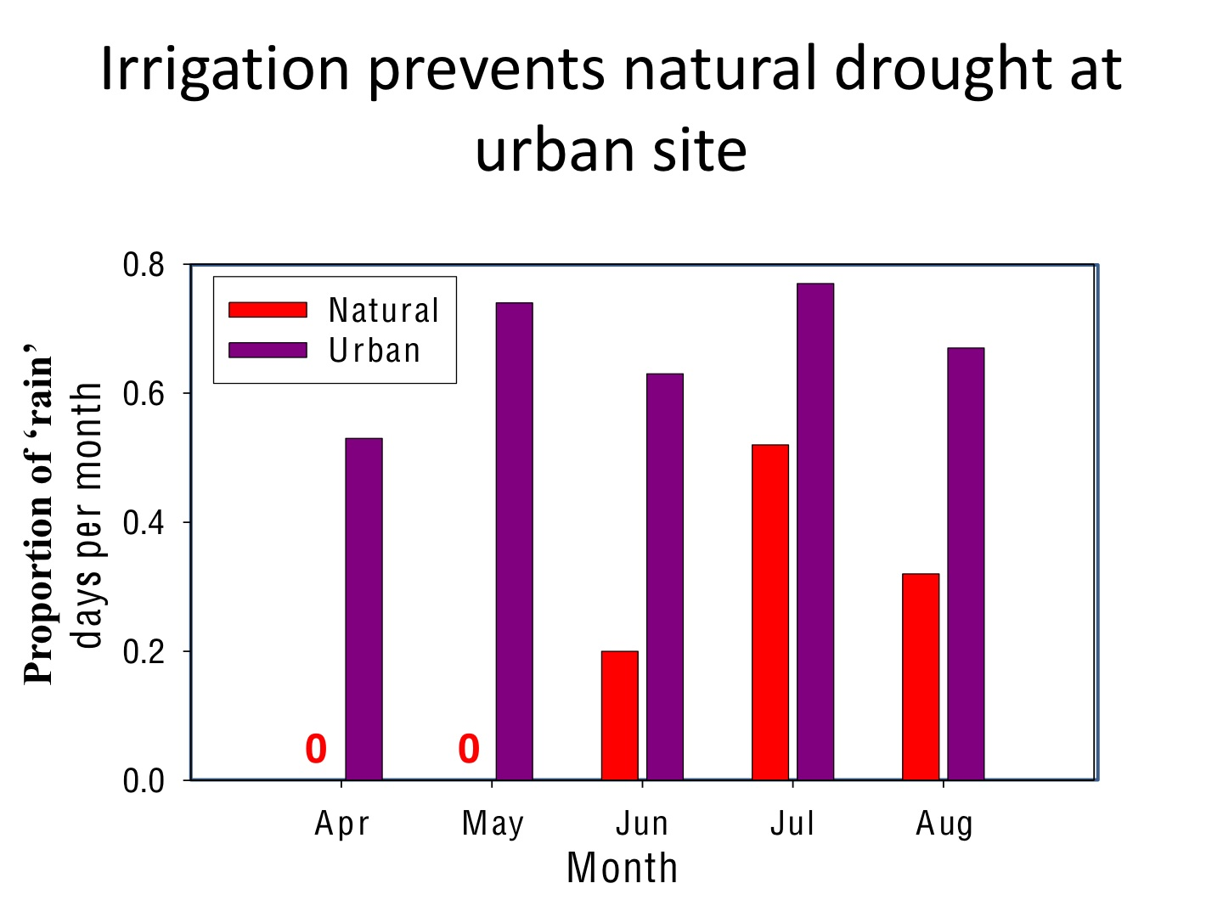
Courtesy Jon Davis and Dale DeNardo, ASU

Slide 16
Notes:
Low density

Slide 17
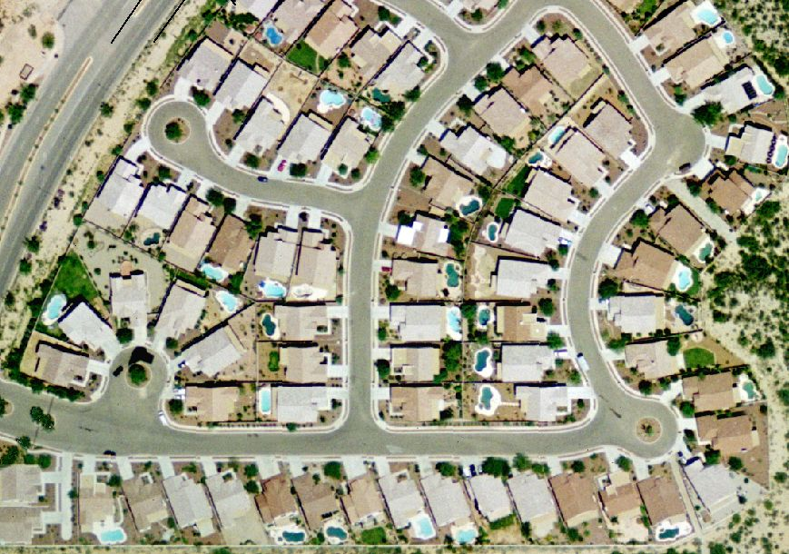
Notes:
High density

Slide 18
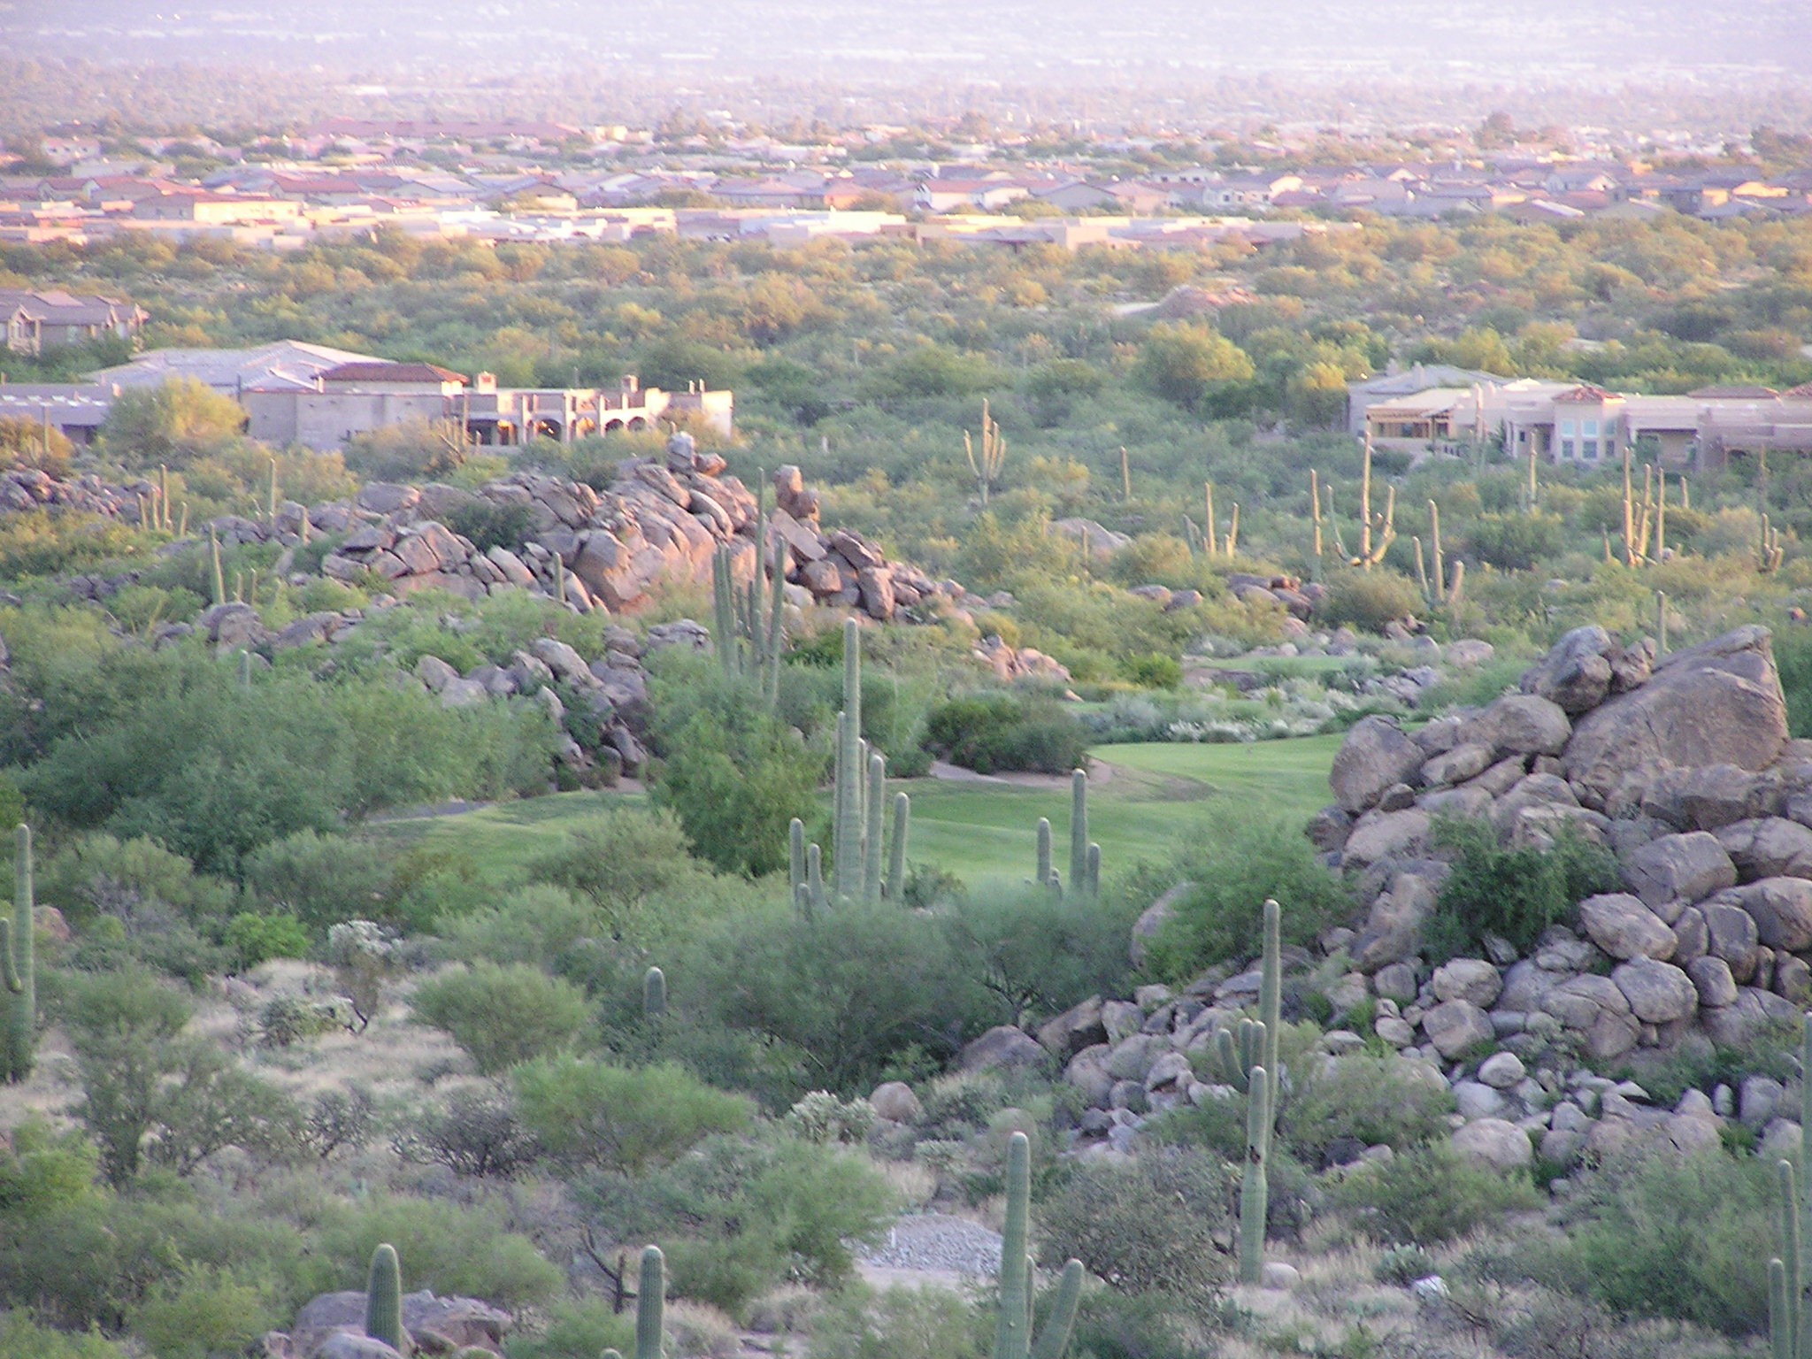
Ecological Trap?

Slide 19
Acknowledgements
Dr. Matt Goode-Mentor
2002-2013 and 2017-2018 Field Assistants
Rene Clark, Dancing Snake Nature Photography
Stone Canyon: Mike Russell, Kelly Mainvielle, Club Staff, HOA/Residents
Funding: University of Arizona NASA Space Grant Consortium, Wallace Research Foundation, AGFD Heritage Fund, NFWF/USGA Wildlife Links Program

Slide 20
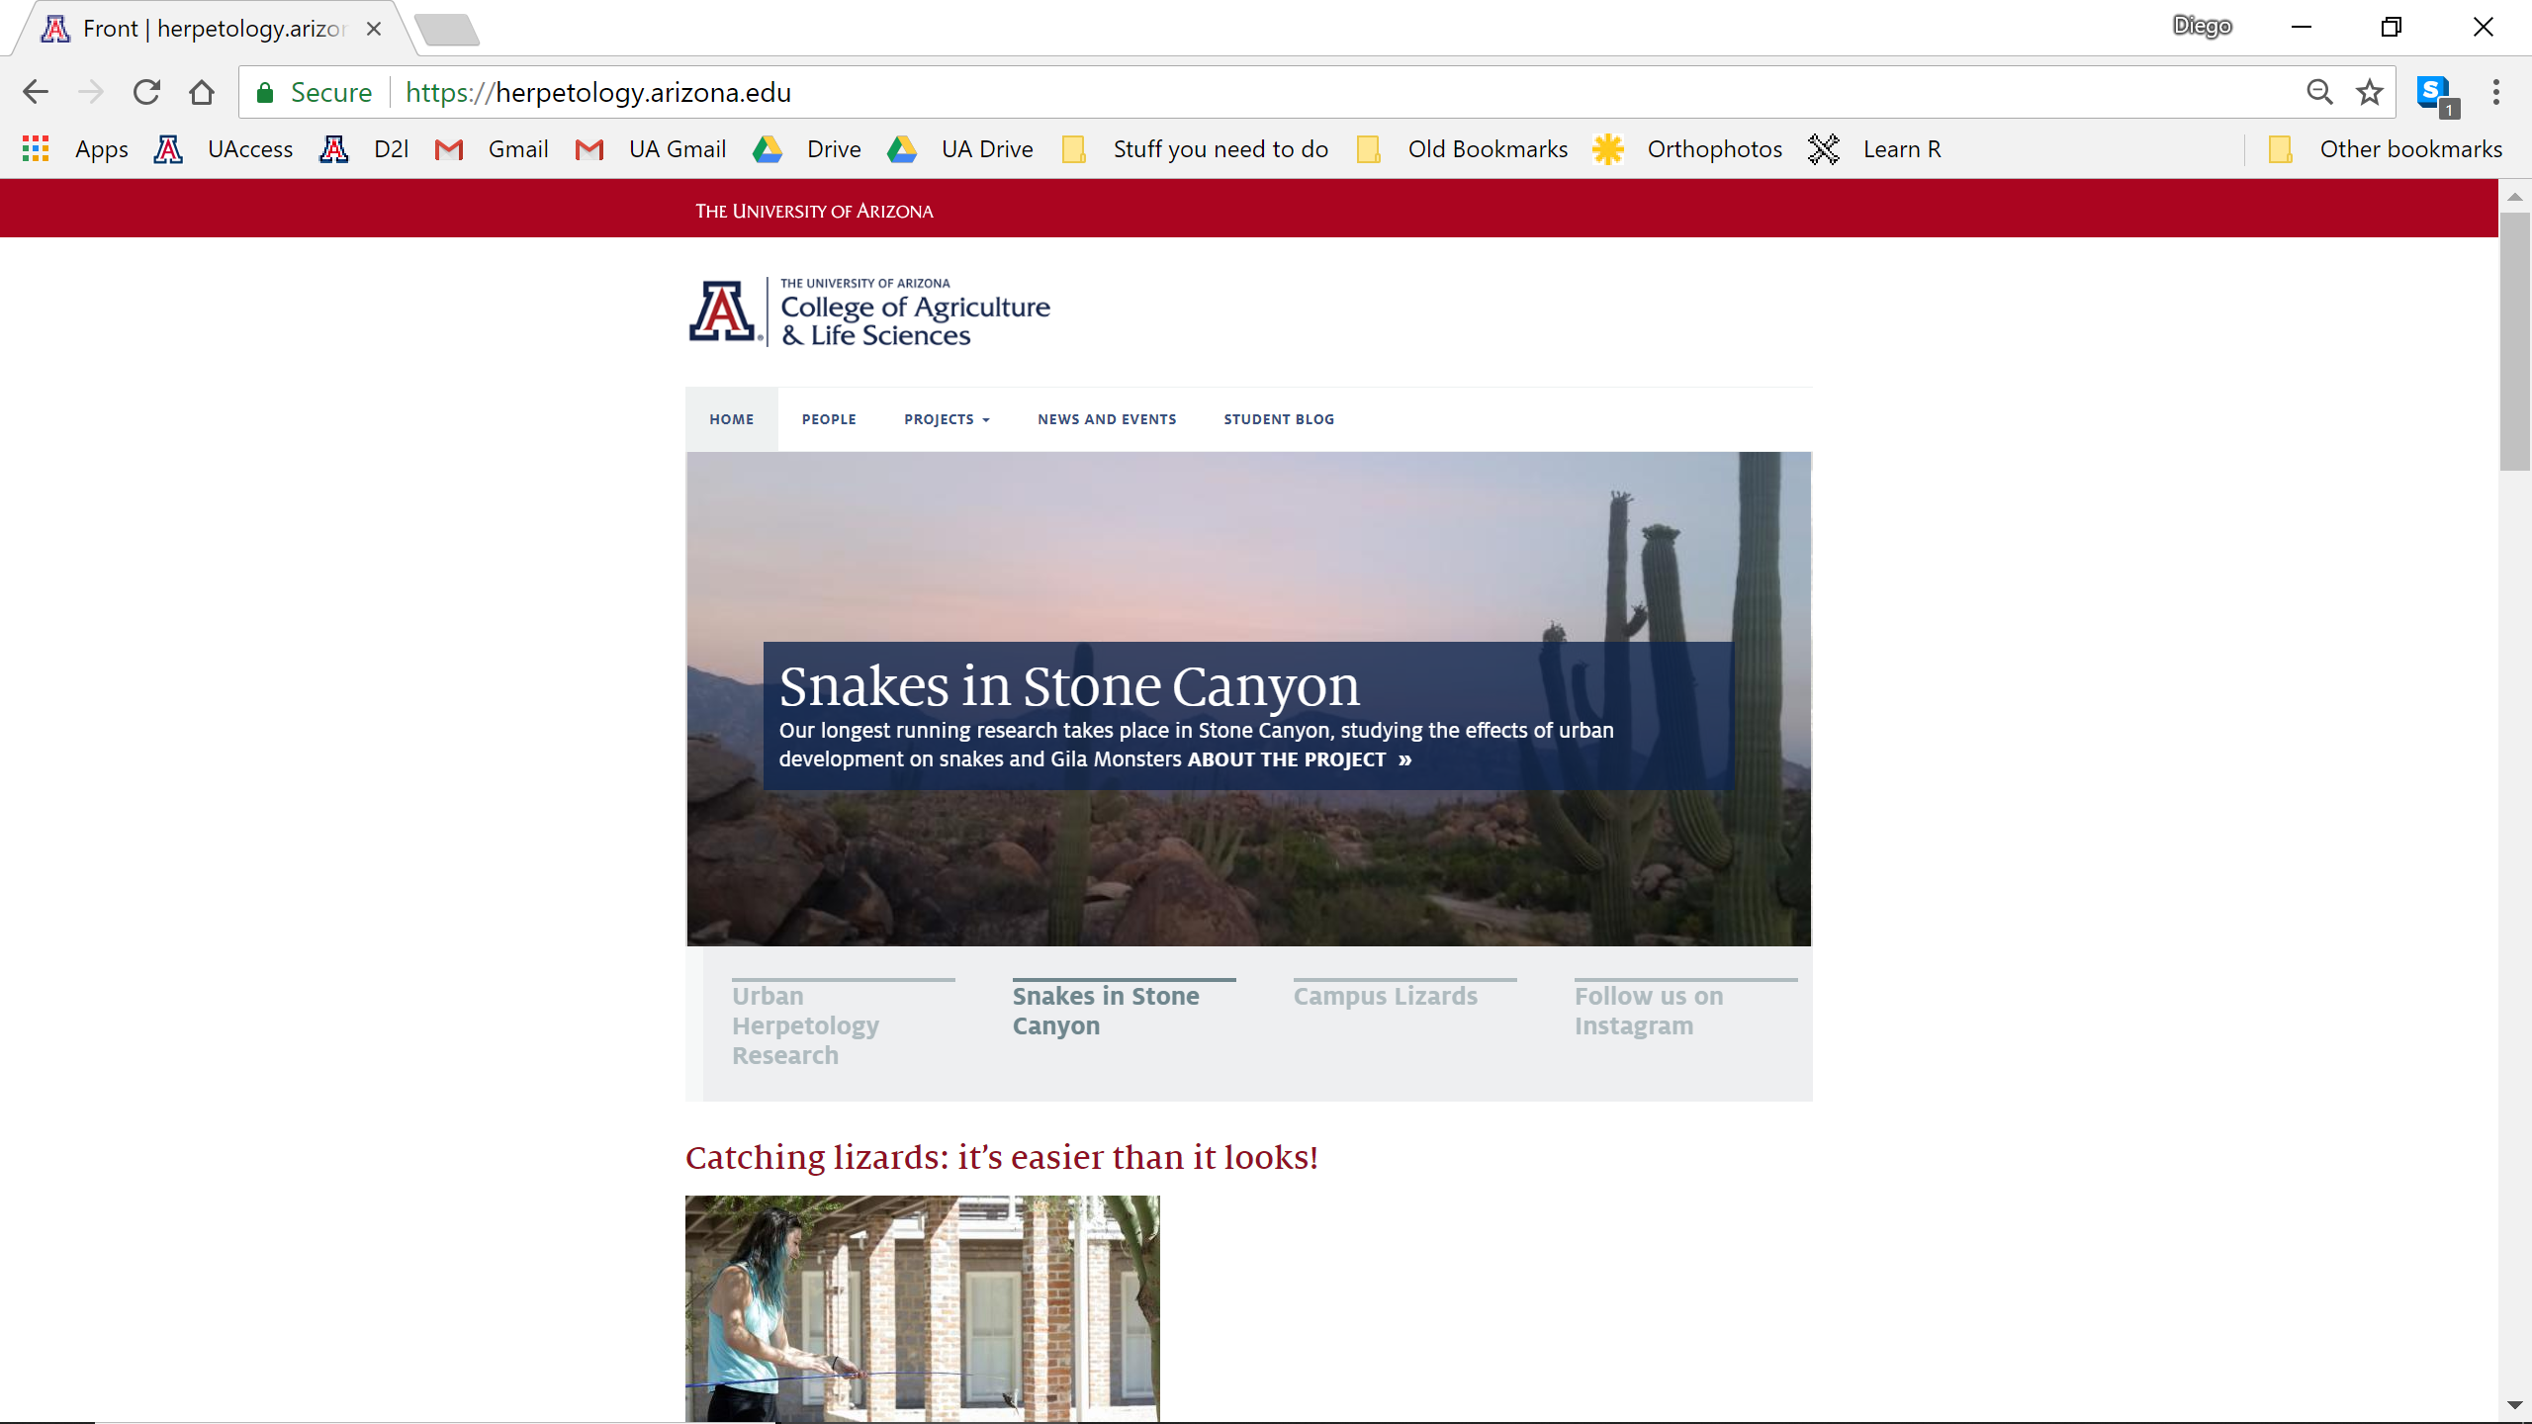
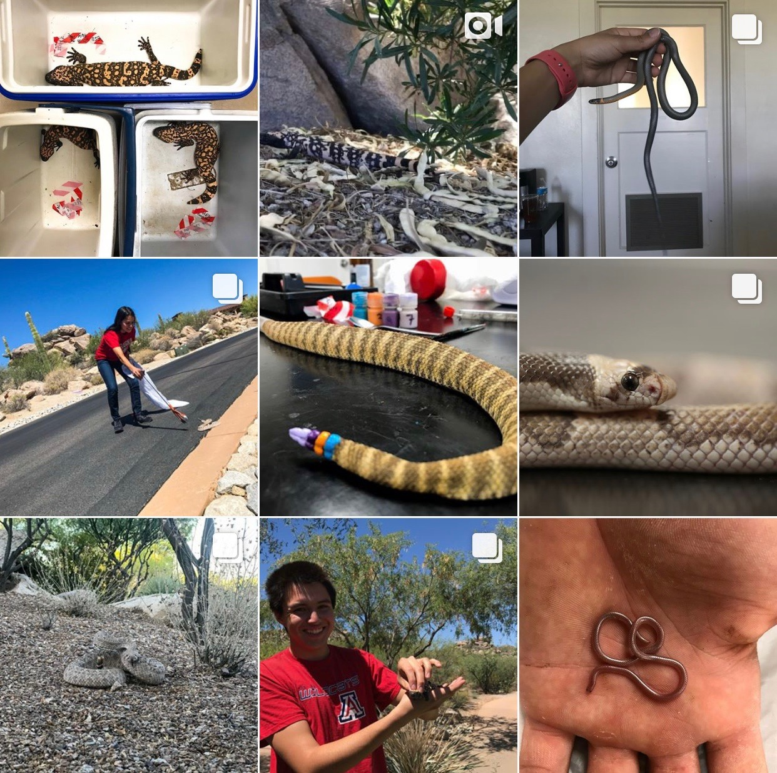


herpetology.arizona.edu
@uaherpetology

